Slide 1


Maximising TelCo Company Profits With Customer Churn Prediction Models
https://github.com/MathiasSteilen/CAIML-Supervised-ML-Group-Project.git
Concepts, Applications, and Implications in Machine Learning and Artificial Intelligence
Group 2
Tobias Jucker (16-611-485)
Jingxuan Song (22-602-593)
Mathias Steilen (19-608-512)
Dan (Doris) Wang (22-621-452)
15th Dec. 2022
Notes:
I welcome you to our Presentation about maximizing the profits of TelCo Company. We maximize the profits by using a customer churn prediction model

Slide 2
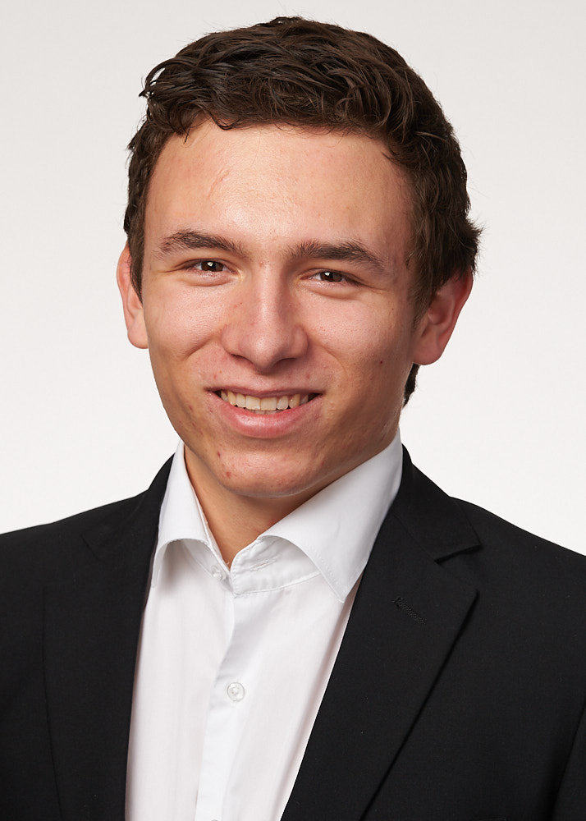
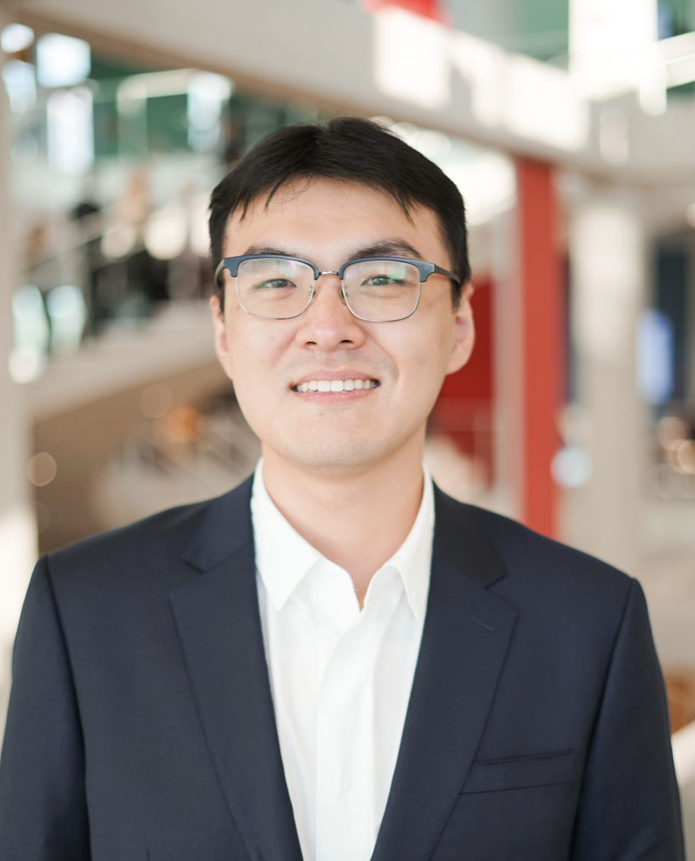
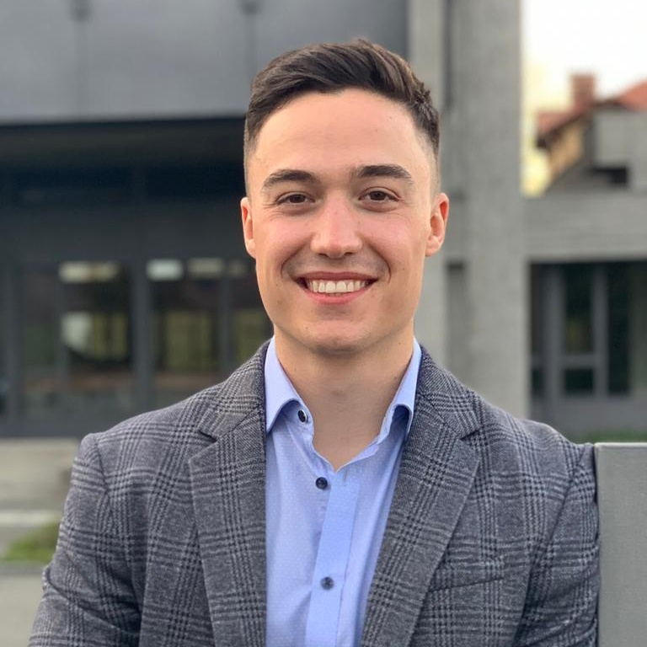
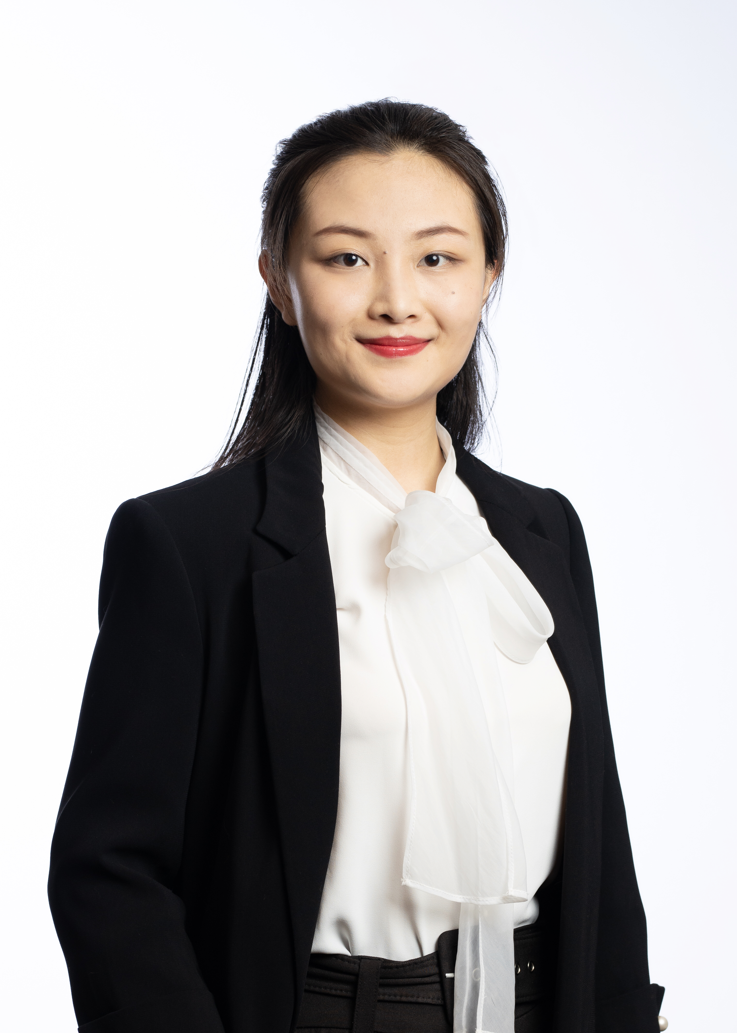
Our team
Tobias Jucker
Jingxuan Song
Mathias Steilen
Dan (Doris) Wang
HSG
MAccFin
ESADE & HSG
CEMS MiM
HSG
MBF
Aalto & HSG
CEMS MiM
Notes:
Who are we? Jingxuan, Mathias, Doris and I worked together on this interesting project.

Slide 3
Agenda
Context & Data
Exploratory Data Analysis (EDA)
Model Creation
Model Performance
The Business Case
Ethics Discussion
Notes:
How do we go about?
First we introduce the context and data.
Then we present the exploratatory data anaylsis and how we created the models.
Afterwards we talk about the model performance and business case application.
Finally, we finish with an ethics discussion.

Slide 4
Context & Data
Why customer churn matters and how do we address the problem?

Slide 5




Business Insight
Problem Statement
Data & Packages
Data Analysis
Model Creation
Performance Evaluation
Business Case & Ethics
Fierce competition in telecommunications sector
Goal
Predict whether customers will churn and take actions in advance to retain them
6-7 times lower costs to retain than to acquire customers
Transition from product-centric to customer-centric
Sources: (Zhao, Zeng, Chang, Tong, & Su, 2021, p. 2), (Karanovic, Popovac, Sladojevic, Arsenovic, & Stefanovic, 2018, p. 1).
Notes:
Whats the background?
There is fierce competition in the telecommunications sector
Generally, it is 6-7 times cheaper to retain than to acquire customers.
Therefore, there is a transition from product-centric to customer-centric.
What is our goal? We want to predict whether a customer will churn and then take actions in advance to retain them.

Slide 6
Data & Packages
Problem Statement
Data & Packages
Data Analysis
Model Creation
Performance Evaluation
Business Case & Ethics
Data Wrangling
Modeling
Dealing with class imbalance
Tidyverse, Broom
Tidymodels, Stacks
Themis
Data
Variable Importance
Plots
Parallelisation for Hyperparameter Tuning
Kaggle (IBM Data Science Challenge) - Telco Customer Churn
Vip
DoParallel
Notes:
How did we do it?
We used tidymodels. We used tidymodels for two reasons: First, it unifies different packages into one unified syntax, second: it goes well with our datawrangling as for example the pipe symbol.
Our data is from a fictional IBM Dataset from a Kaggle competition
We followed a clear structure going from procuring, to wrangling and modelling to the business case

Slide 7
Exploratory Data Analysis (EDA)
A brief overview over the most striking relationships

Slide 8
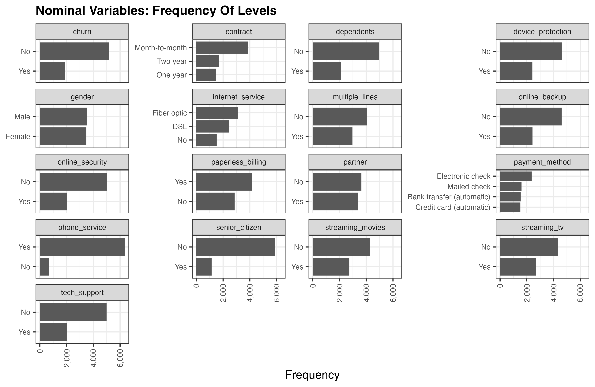
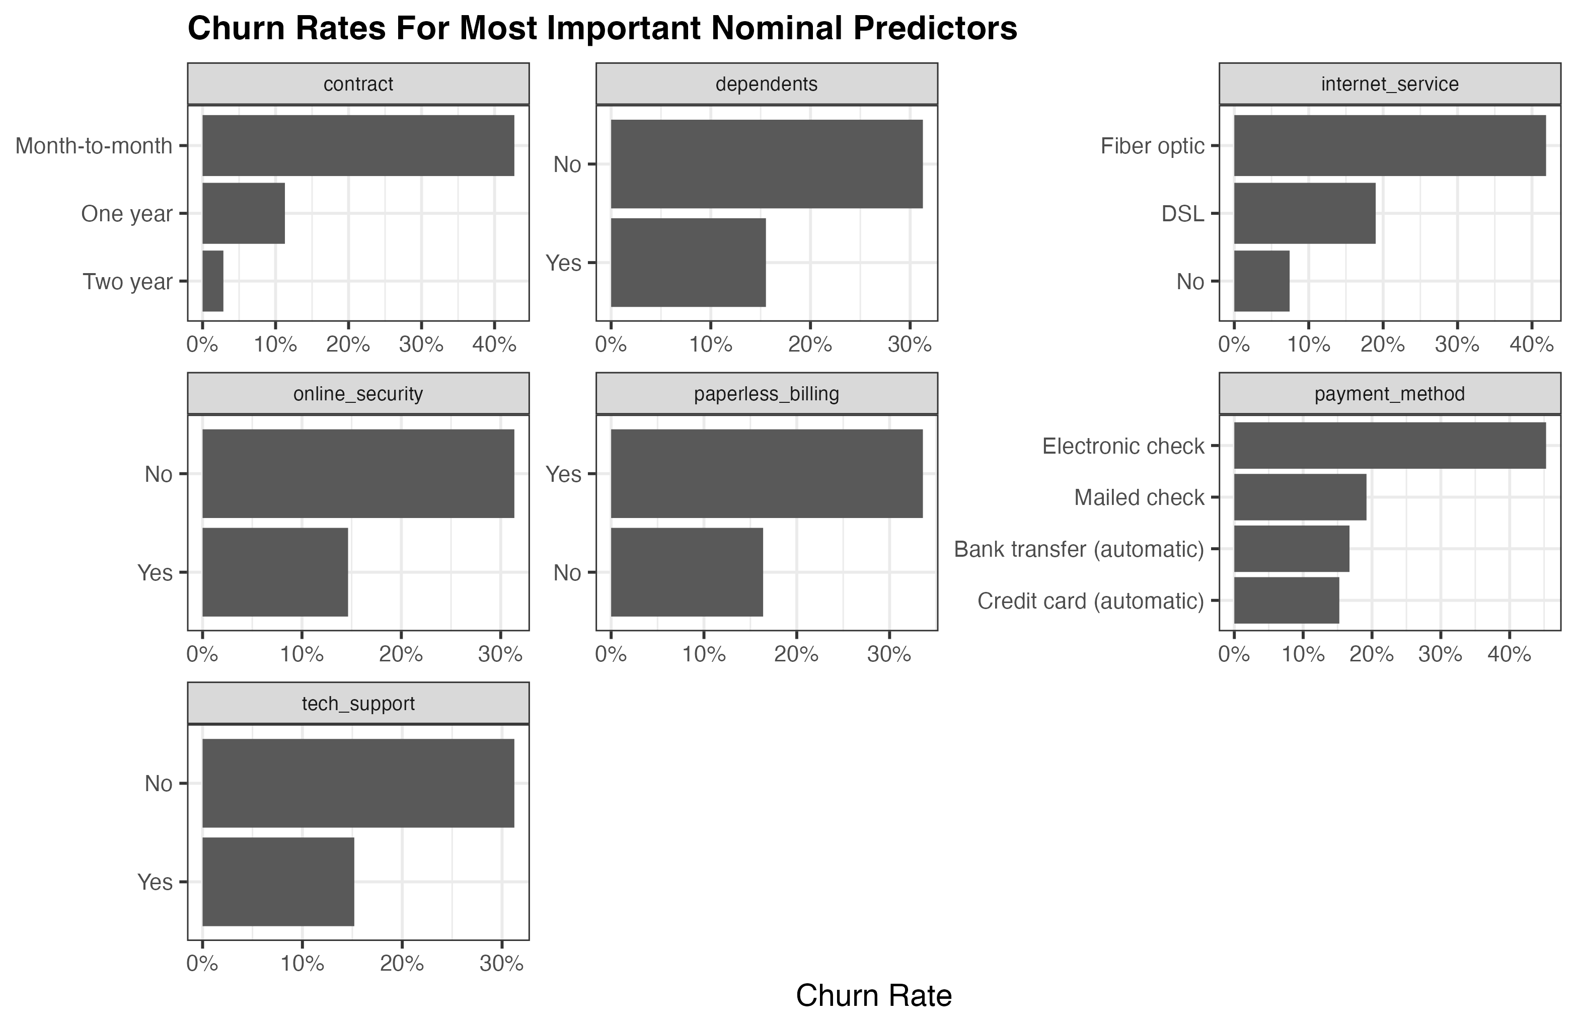
Exploratory Data Analysis (EDA) - 17 Nominal Variables
Problem Statement
Data & Packages
Data Analysis
Model Creation
Performance Evaluation
Business Case & Ethics
Class imbalance for target variable
→ Upsampling with SMOTE
A customer is more likely to churn when the flexibility to change is high and dependency of the company is low.
Notes:
Class imbalance for target variable - upsampling may needed
Customers with month-to-month contracts, no dependents, fiber optic internet service, no online-security service, paperless billing, electronic check, no technology support are most likely to churn, which makes sense because it is easier to churn when the flexibility and dependency of the customer is low.

Slide 9
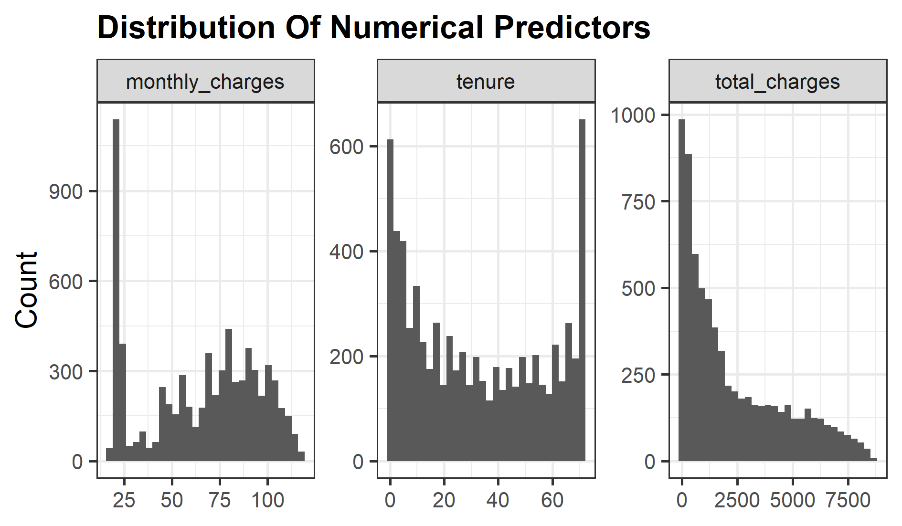
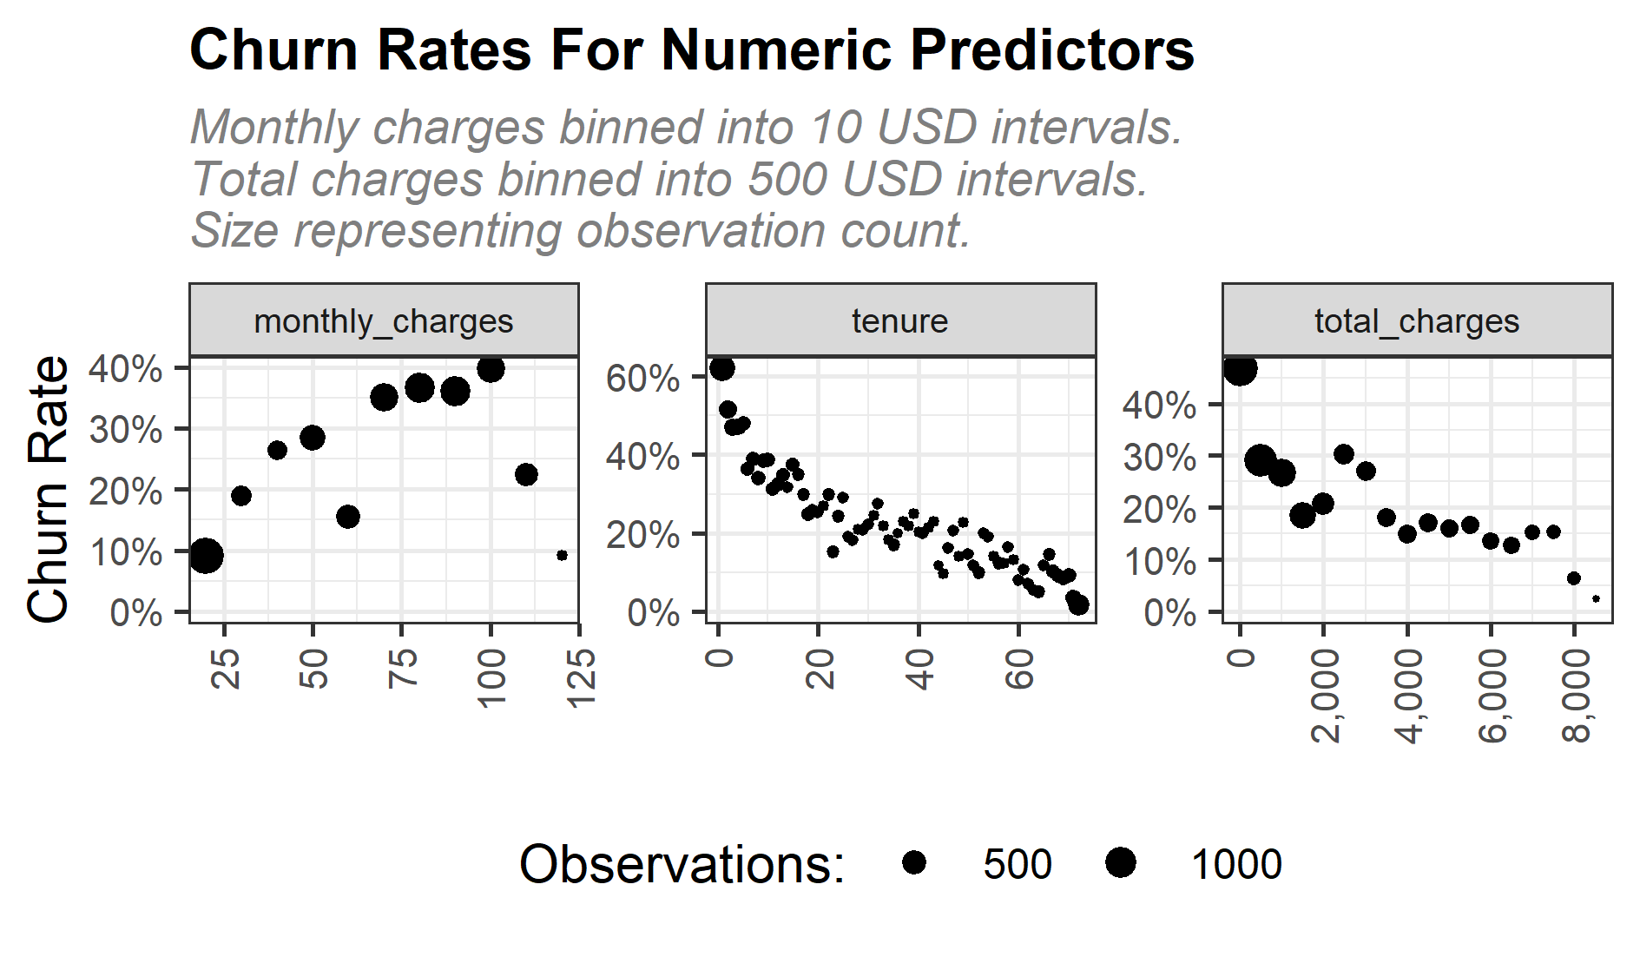
Exploratory Data Analysis (EDA) - 3 Numerical Variables
Problem Statement
Data & Packages
Data Analysis
Model Creation
Performance Evaluation
Business Case & Ethics
Monthly charges are mostly around 25 dollars
There are considerable number of new and loyal customers according to the tenure
→ necessity to retain
Higher monthly charges → higher churn rate
Higher tenure → lower churn rate
Higher total charge → lower churn rate

Slide 10
Model Creation
Splits, Folds, Preprocessing, Hyperparameter Tuning, Training

Slide 11
Model Summary
Problem Statement
Data & Packages
Data Analysis
Model Creation
Performance Evaluation
Business Case & Ethics
Removed customerID
Normalised numerical variables
One-hot encoded nominal variables
Removed zero variance variables
Upsampled target variable
Classification
Task
75% training set
25% testing set
Preprocessing
Train-Test Split
Gradient Boosting
K-Nearest Neighbors
Random Forest
Logistic Regression
Linear Support Vector Machine (SVM)
Radial Basis Function (RBF) kernel SVM
6 different models
5-fold cross validation resampling
Hyperparameter tuning
Stacked model
ROC – AUC
Confusion Matrix
Evaluation
LASSO model to linearly blend model predictions into a stacked model
Notes:
Generally, the tree-based ensembles show highest accuracy, but random forests show low sensitivity. Couples with its high precision, but comparatively low recall, we can deduct that it is a little conservative on predicting that a customer is going to leave.
Furthermore, the non-linear SVM has highest recall, but lowest precision. Looking at the sensitivity
(high) and specificity (low), it becomes clear that it is a very trigger happy in predicting a customer
to churn. kNN looks disappointing across the board, also with regard to ROC AUC. Surprisingly,
logistic regression holds up very well, landing in midfield for most metrics, placing it very high on
ROC AUC.
After investigating the hyperparameter tuning results, we have decided that the ROC AUC metric
gives us the best trade-off between specificity and sensitivity. As we have the business perspective
in mind, we have to balance the amount of false positives and false negatives, as either of them
can hurt our business case. If we give out discounts to falsely positives, we waste money on loyal
customers. If we give out vouchers to false negative, we missed the opportunity to potentially
retain a customer who then churned. Therefore, both cases are costly and we cannot just optimise
for either one. ROC AUC appears to be able to strike the balance, which is exactly what we seek.
Therefore, we proceed by setting the hyperparameter combination for each model on maximum
ROC AUC from the cross-validation holdout evaluation and proceed with training all models on
the full training data set.

Slide 12
Model Performance
Measuring model performance and comparing models

Slide 13
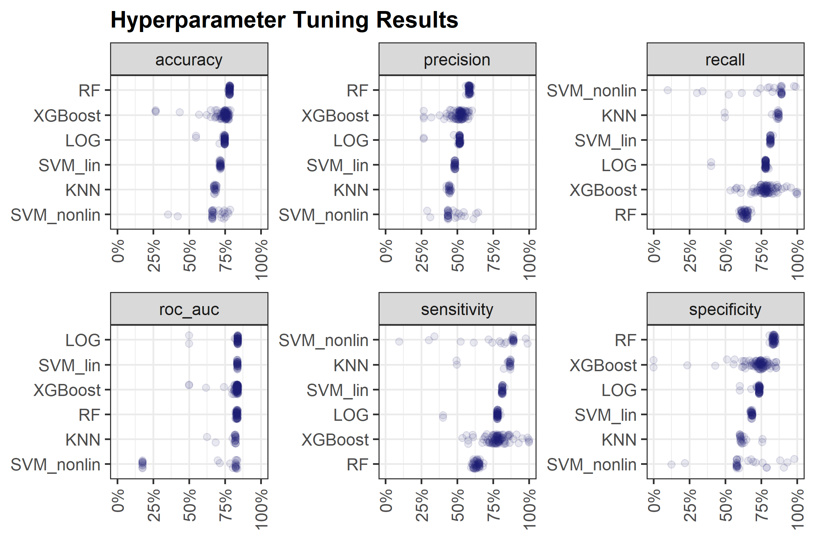
Hyperparameter Tuning
Problem Statement
Data & Packages
Data Analysis
Model Creation
Performance Evaluation
Business Case & Ethics
Each dot: one CV metric for one hyperparameter combination for a given model
Some models required fewer combinations (e.g. kNN, fewer hyperparameters)
Generally: Performance interpretation across models not main intention
Main intention: Find the best hyperparameter combination given some metric within each model
Metric used for final fit: ROC AUC
Decision validated in report

Slide 14
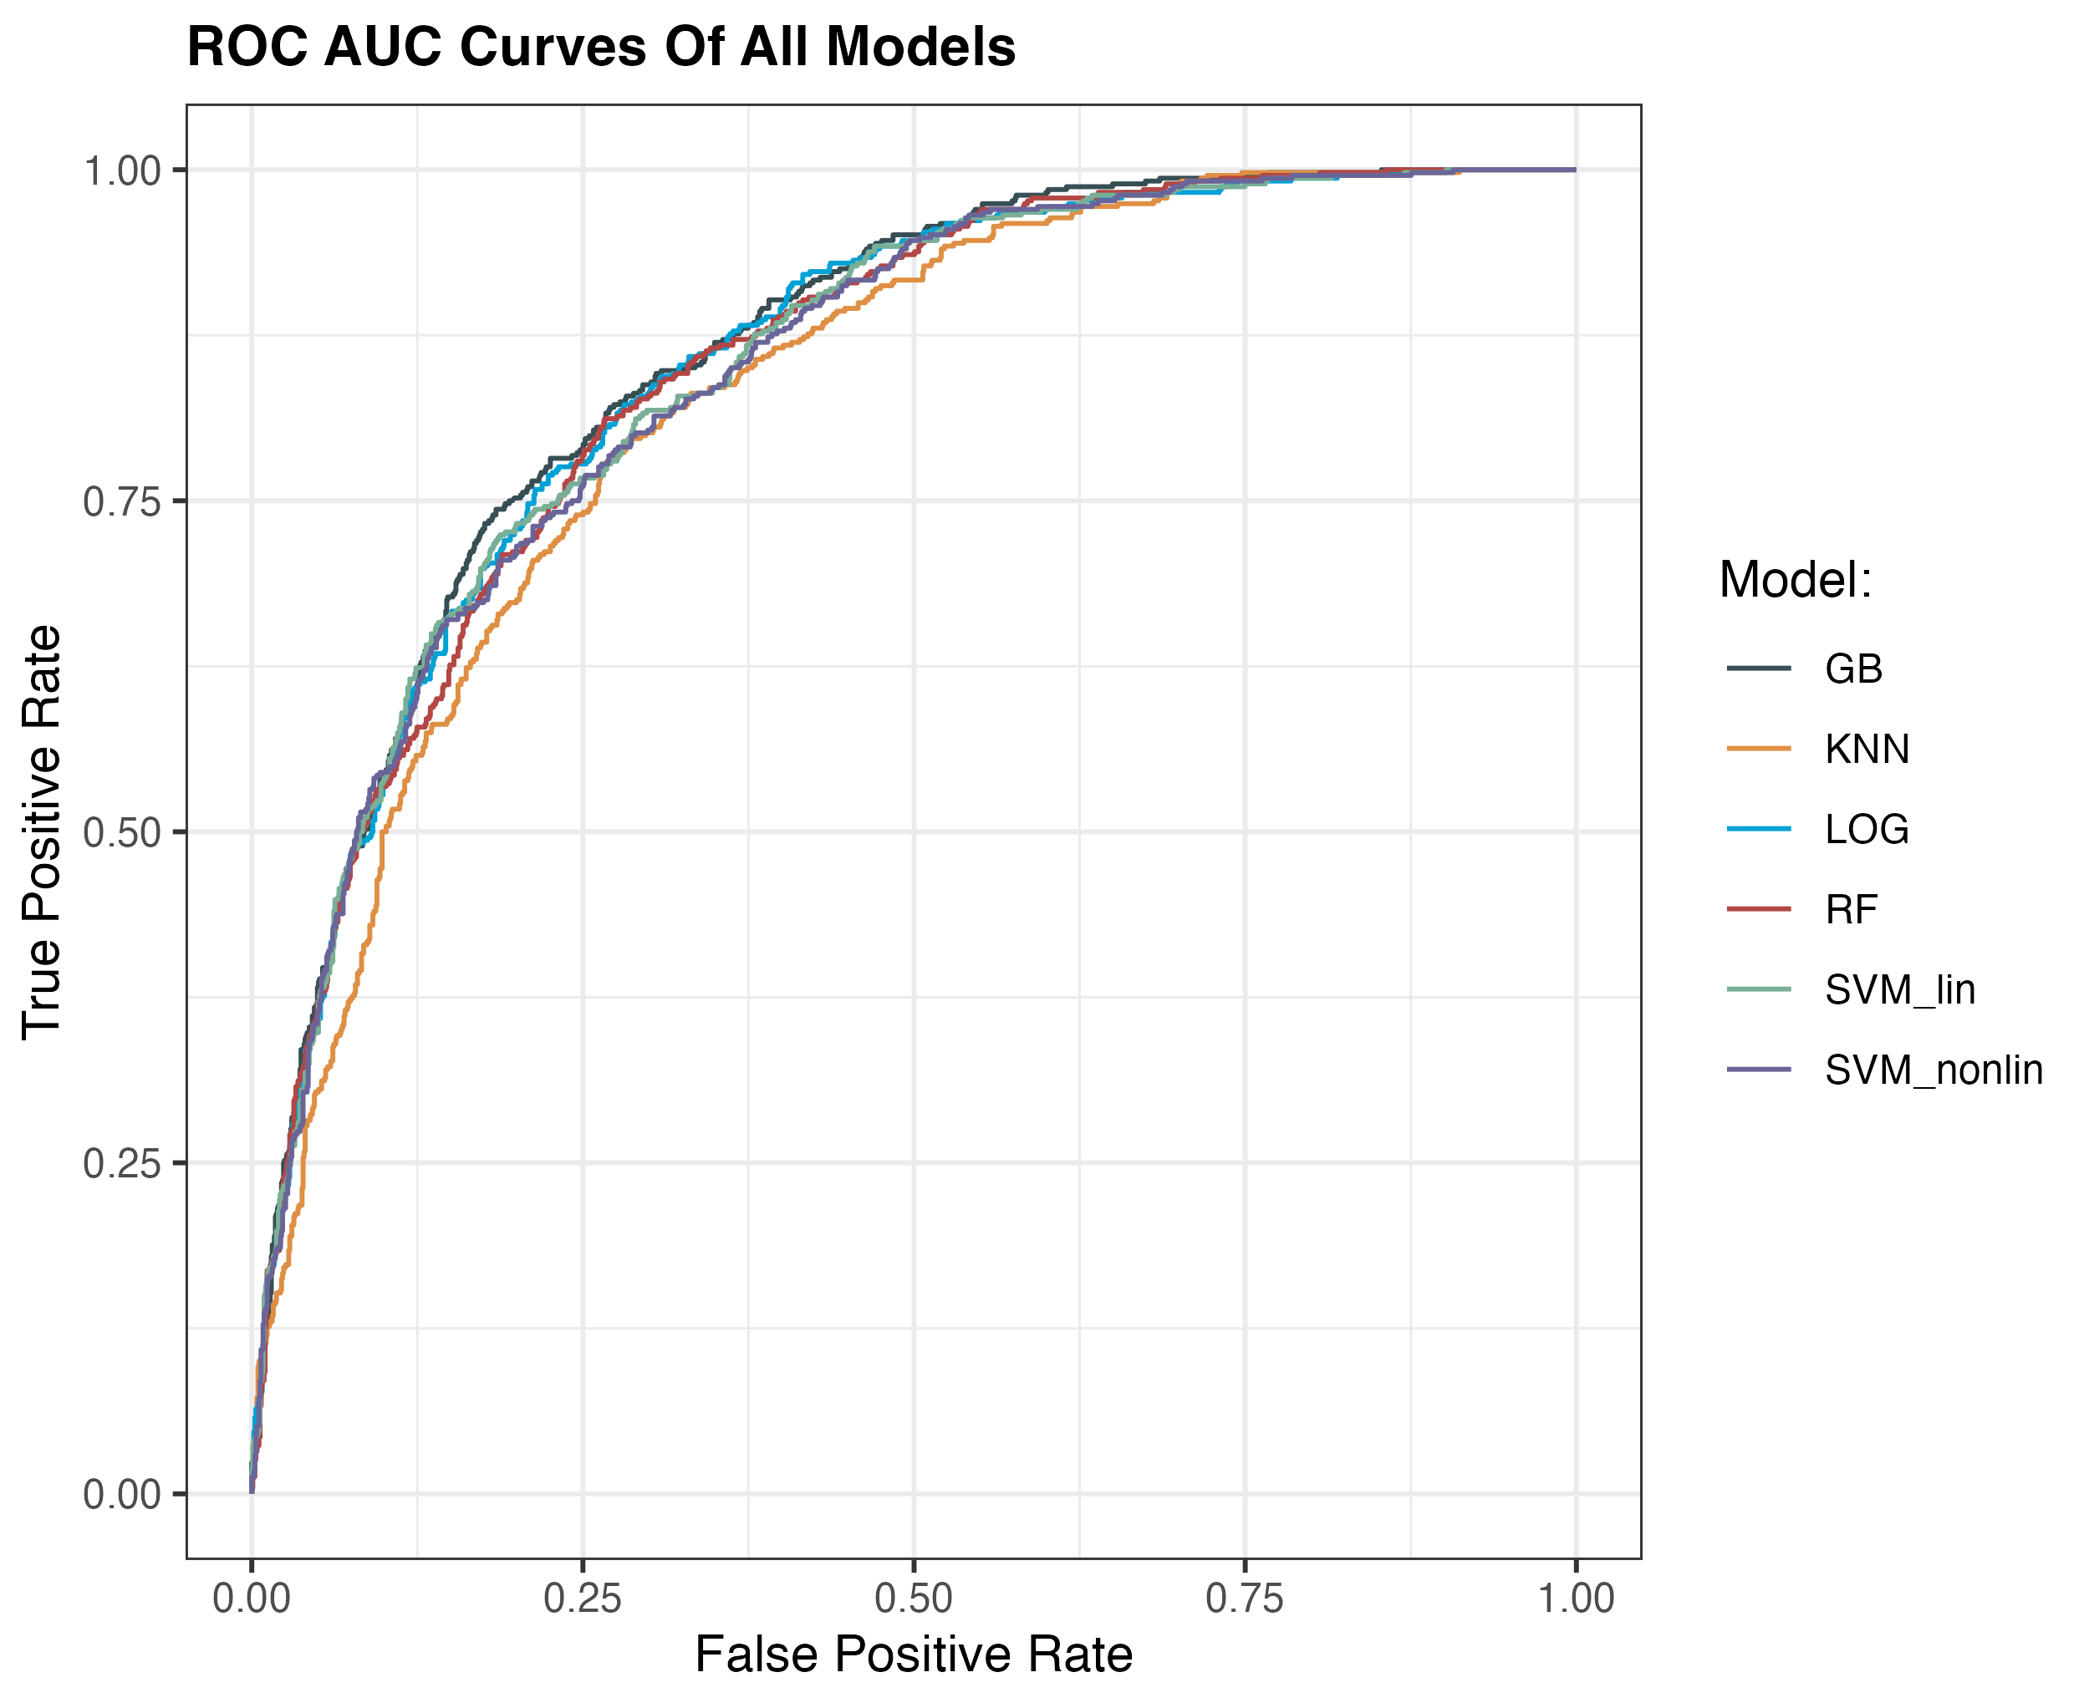
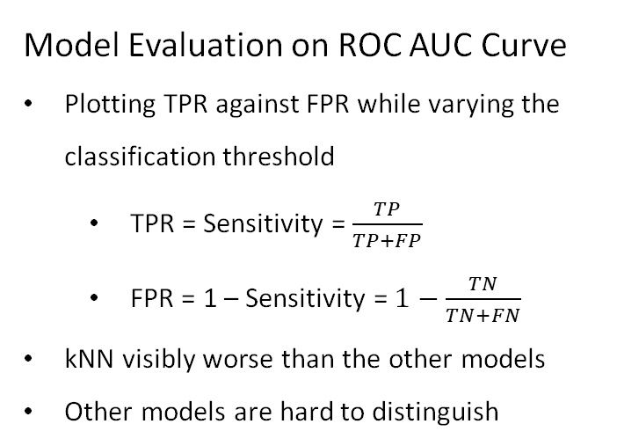
Model Performance
Problem Statement
Data & Packages
Data Analysis
Model Creation
Performance Evaluation
Business Case & Ethics
Model Evaluation on ROC AUC Curve
Plotting TPR against FPR while varying the classification threshold
TPR = Sensitivity = $\frac{TP}{TP+FP}$
FPR = 1 – Sensitivity = $1−\frac{TN}{TN+FN}$
kNN visibly worse than the other models
Other models are hard to distinguish
Notes:
ROC AUC curves
Show behaviour of models when classification thresholds varies
The higher curve lies on upper left, the better model
kNN is visibly worse than others
Other model is hard to distinguish by ROC AUC
An excellent model has AUC near to the 1 which means it has a good measure of separability. A poor model has an AUC near 0 which means it has the worst measure of separability. In fact, it means it is reciprocating the result. It is predicting 0s as 1s and 1s as 0s. And when AUC is 0.5, it means the model has no class separation capacity whatsoever.
ROC is a curve of probability
https://towardsdatascience.com/understanding-auc-roc-curve-68b2303cc9c5

Slide 15
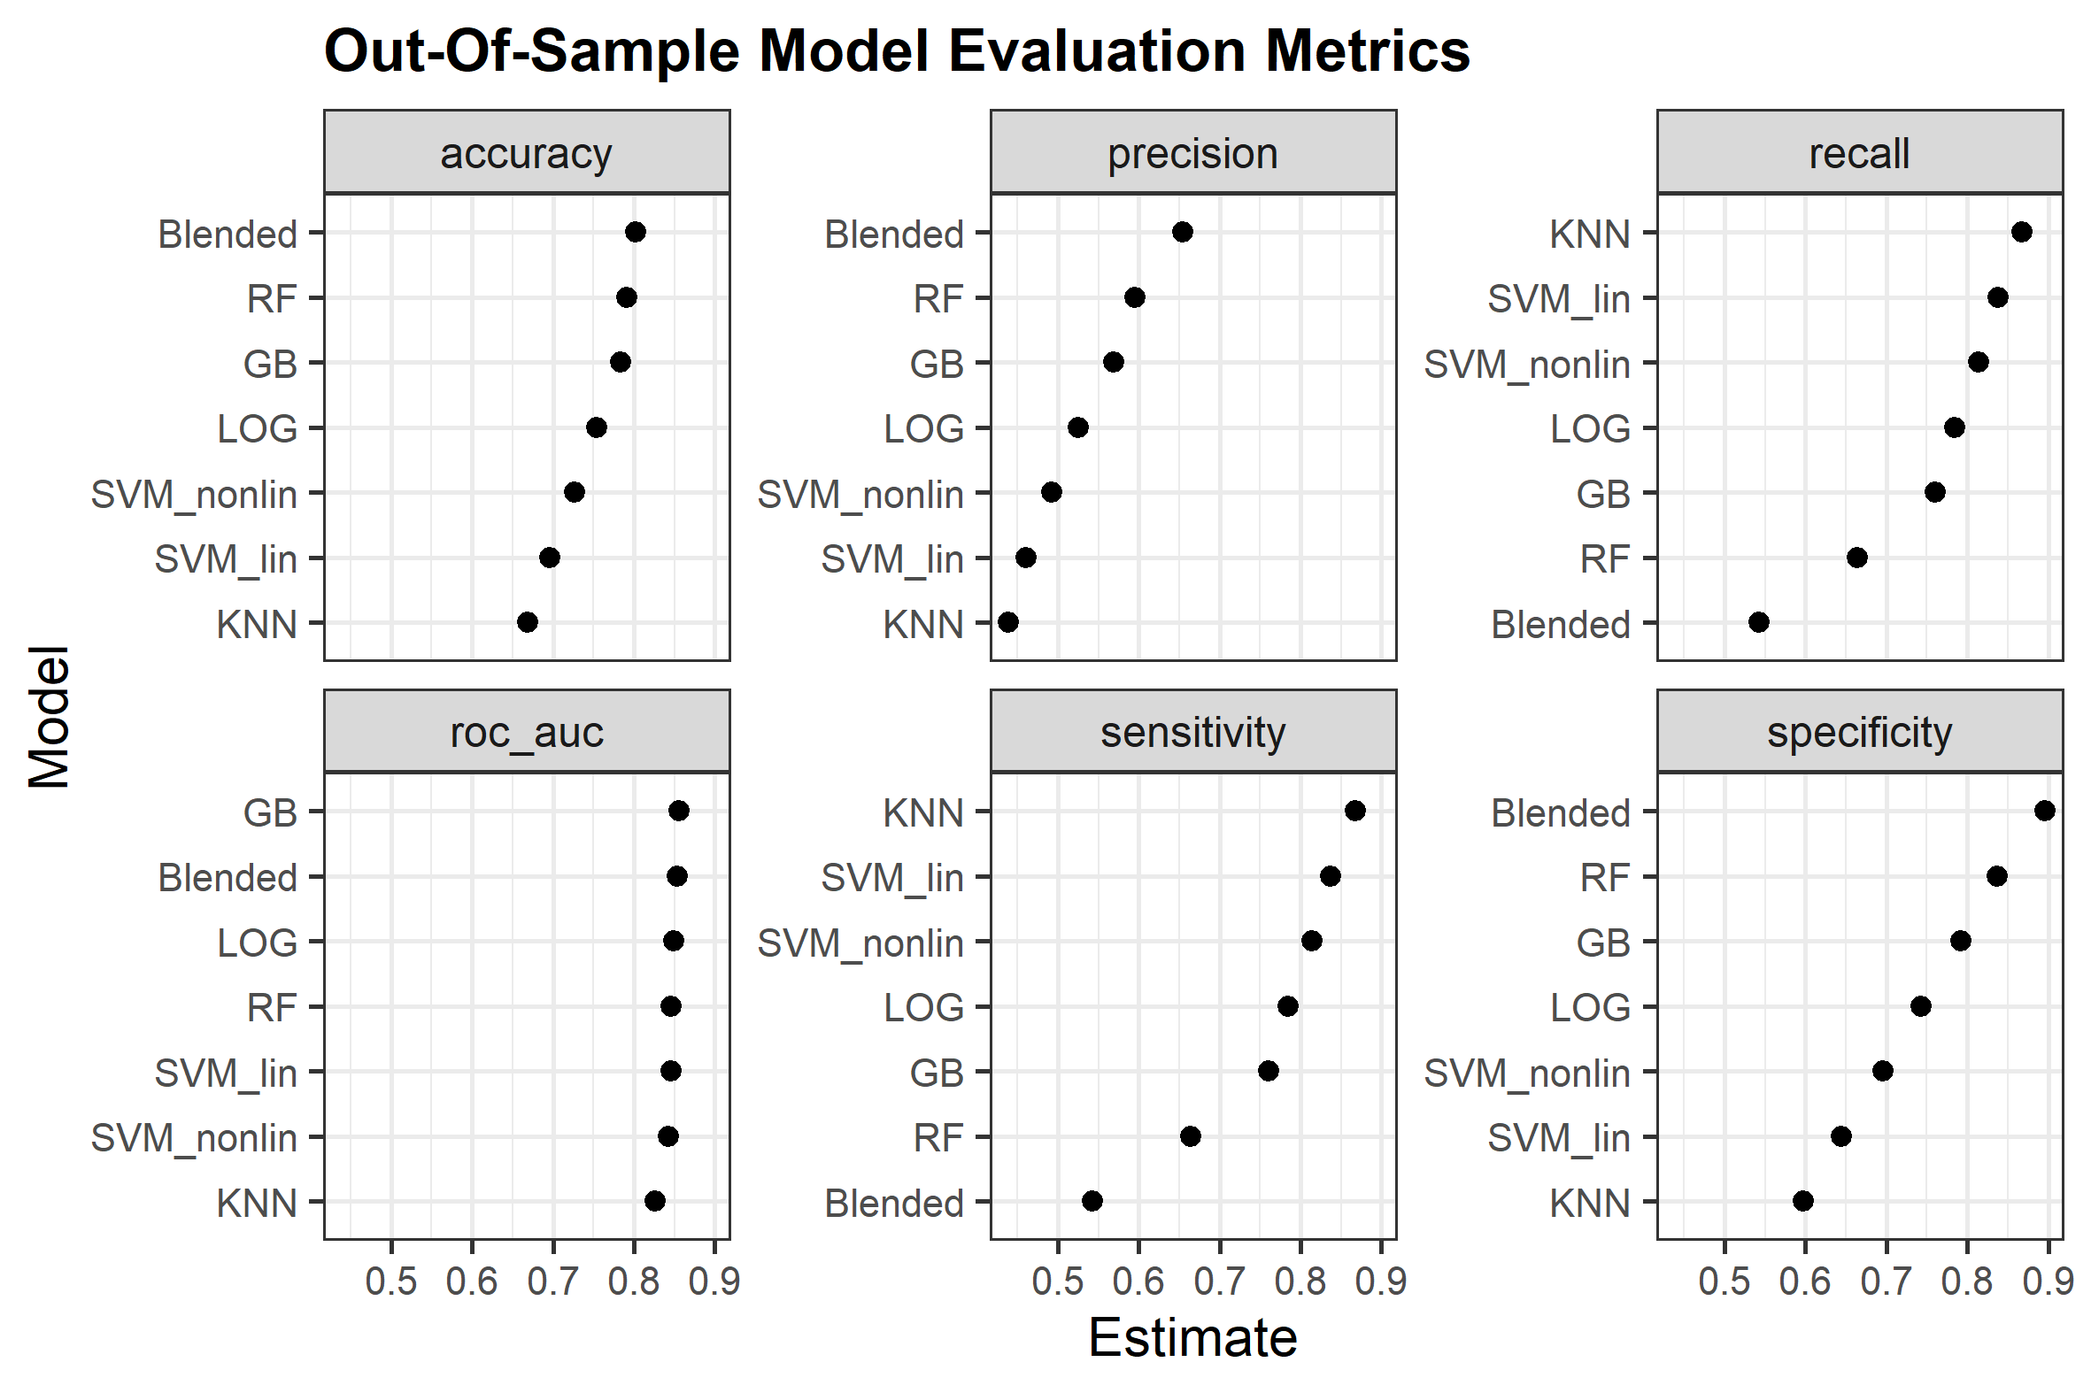
Model Performance
Problem Statement
Data & Packages
Data Analysis
Model Creation
Performance Evaluation
Business Case & Ethics
Model Evaluation on Metrics from Confusion Matrix
Blended Model: Accuracy gives wrong impression, model is too conservative (shown by low sensitivity and high precision)
GB: Great tradeoff between sensitivity and specificity, as shown by ROC AUC (higher separability)
RF: Slightly conservative, however tradeoff better than blended model
SVM: Both too trigger happy, as high sensitivity, but low precision
LOG: Almost eye to eye with GB, given simplicity and speed, great candidate
Precision is lower than recall for all the models
Notes:
Final judgement reserved to business case!

Slide 16
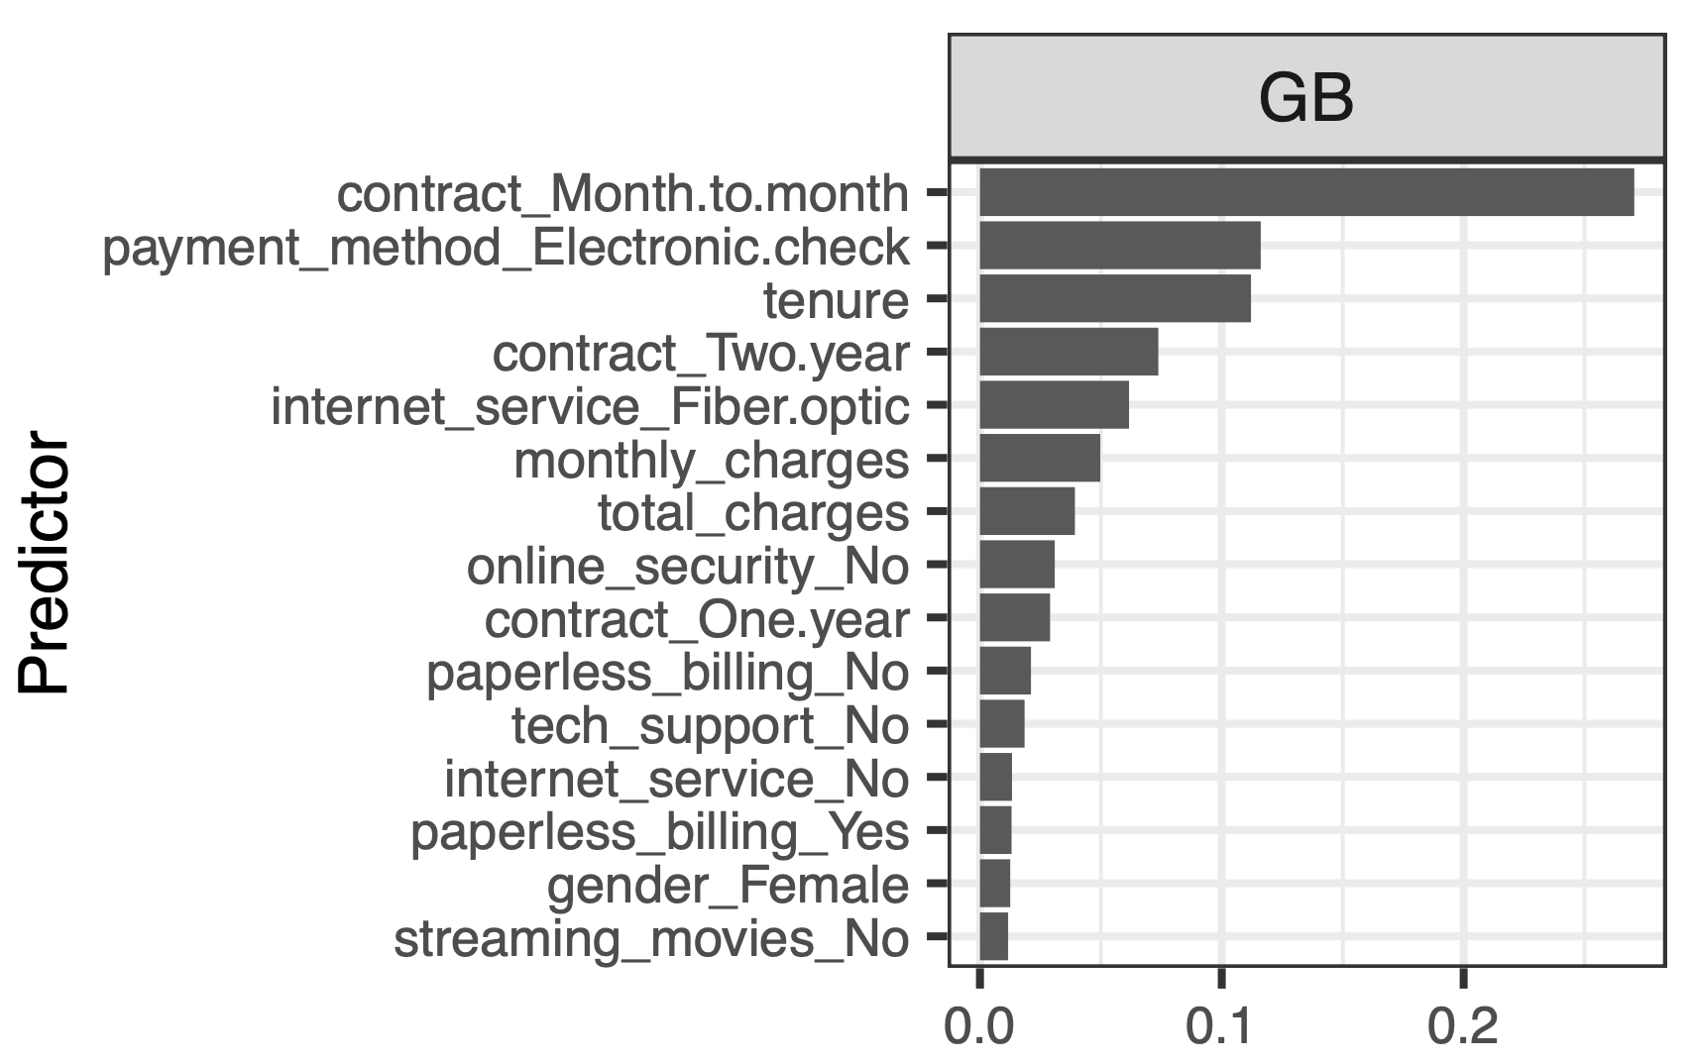
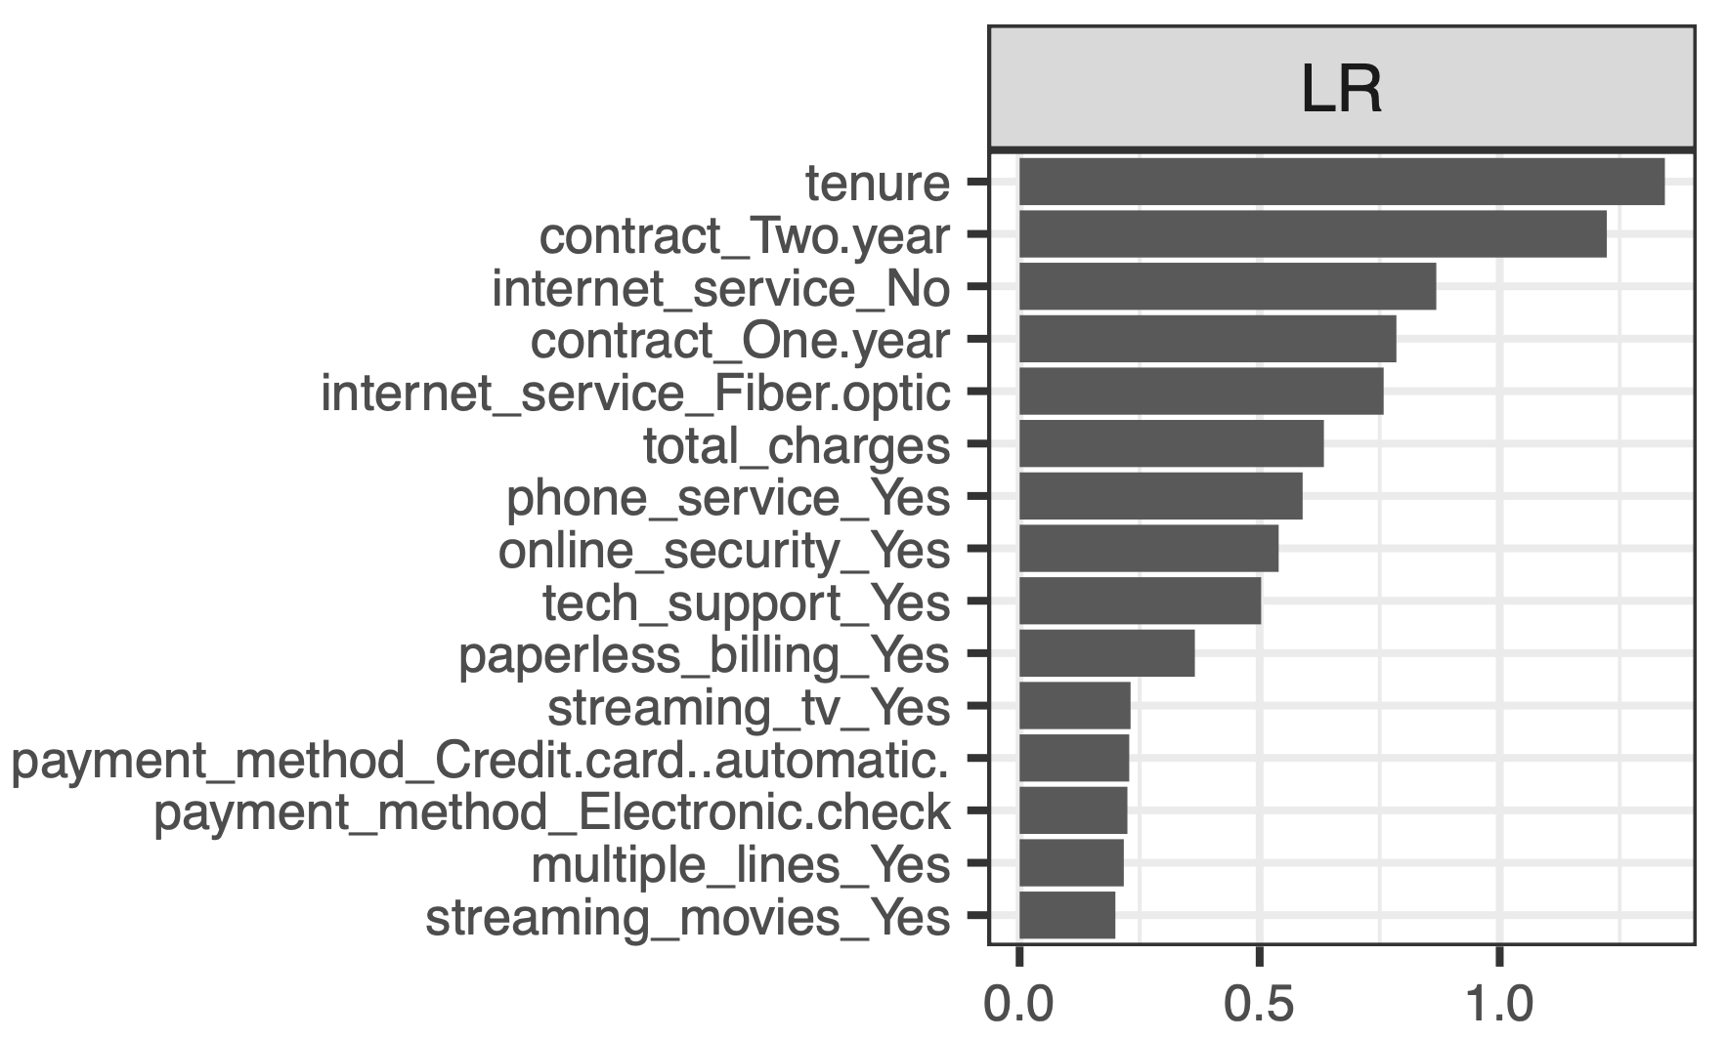
Variable Importance: Gini Impurity
Problem Statement
Data & Packages
Data Analysis
Model Creation
Performance Evaluation
Business Case & Ethics
Comparable, but not the same:
Important:
Contract types
Tenure
Less important (reference to Ethics section):
Partners/Dependents
Gender

Slide 17
The Business Case
How does all of this generate value in practice?

Slide 18
Simple Business Case
Problem Statement
Data & Packages
Data Analysis
Model Creation
Performance Evaluation
Business Case & Ethics
Predicted: Leave
Customer: Leave
Predicted: Leave
Customer: Stay
Assumptions
$500 profit per period for a non-churning customer
$0 profit if a customer leaves
33.3% discount to predicted churning customers
50% of churning customer that receive discount will stay
True Positive (TP) | False Positive (FP)
Profit = N_{TP}*500*0.5*66.7% | Profit = N_{FP}*500*66.7%
False Negative (FN) | True Negative (TN)
Profit = 0 | Profit = N_{TN}*500
Predicted: Stay
Customer: Leave
Predicted: Stay
Customer: Stay
Notes:
Example of 500 USD vs 0 USD ->
Profit Curves Charts (by Confusion matrix)
Both SVM methods are erratic or narrow value add threshold range
kNN is insufficient, corresponding to ROC AUC result
Tree based model and logistic regression looks promising (smoother lines and wider range)
Classification threshold of tree-based model are much lower -> better trade-off at default threshold?
(Winner!) Random forest generates highest profit
Stack linear model performance is not comparable?

Slide 19
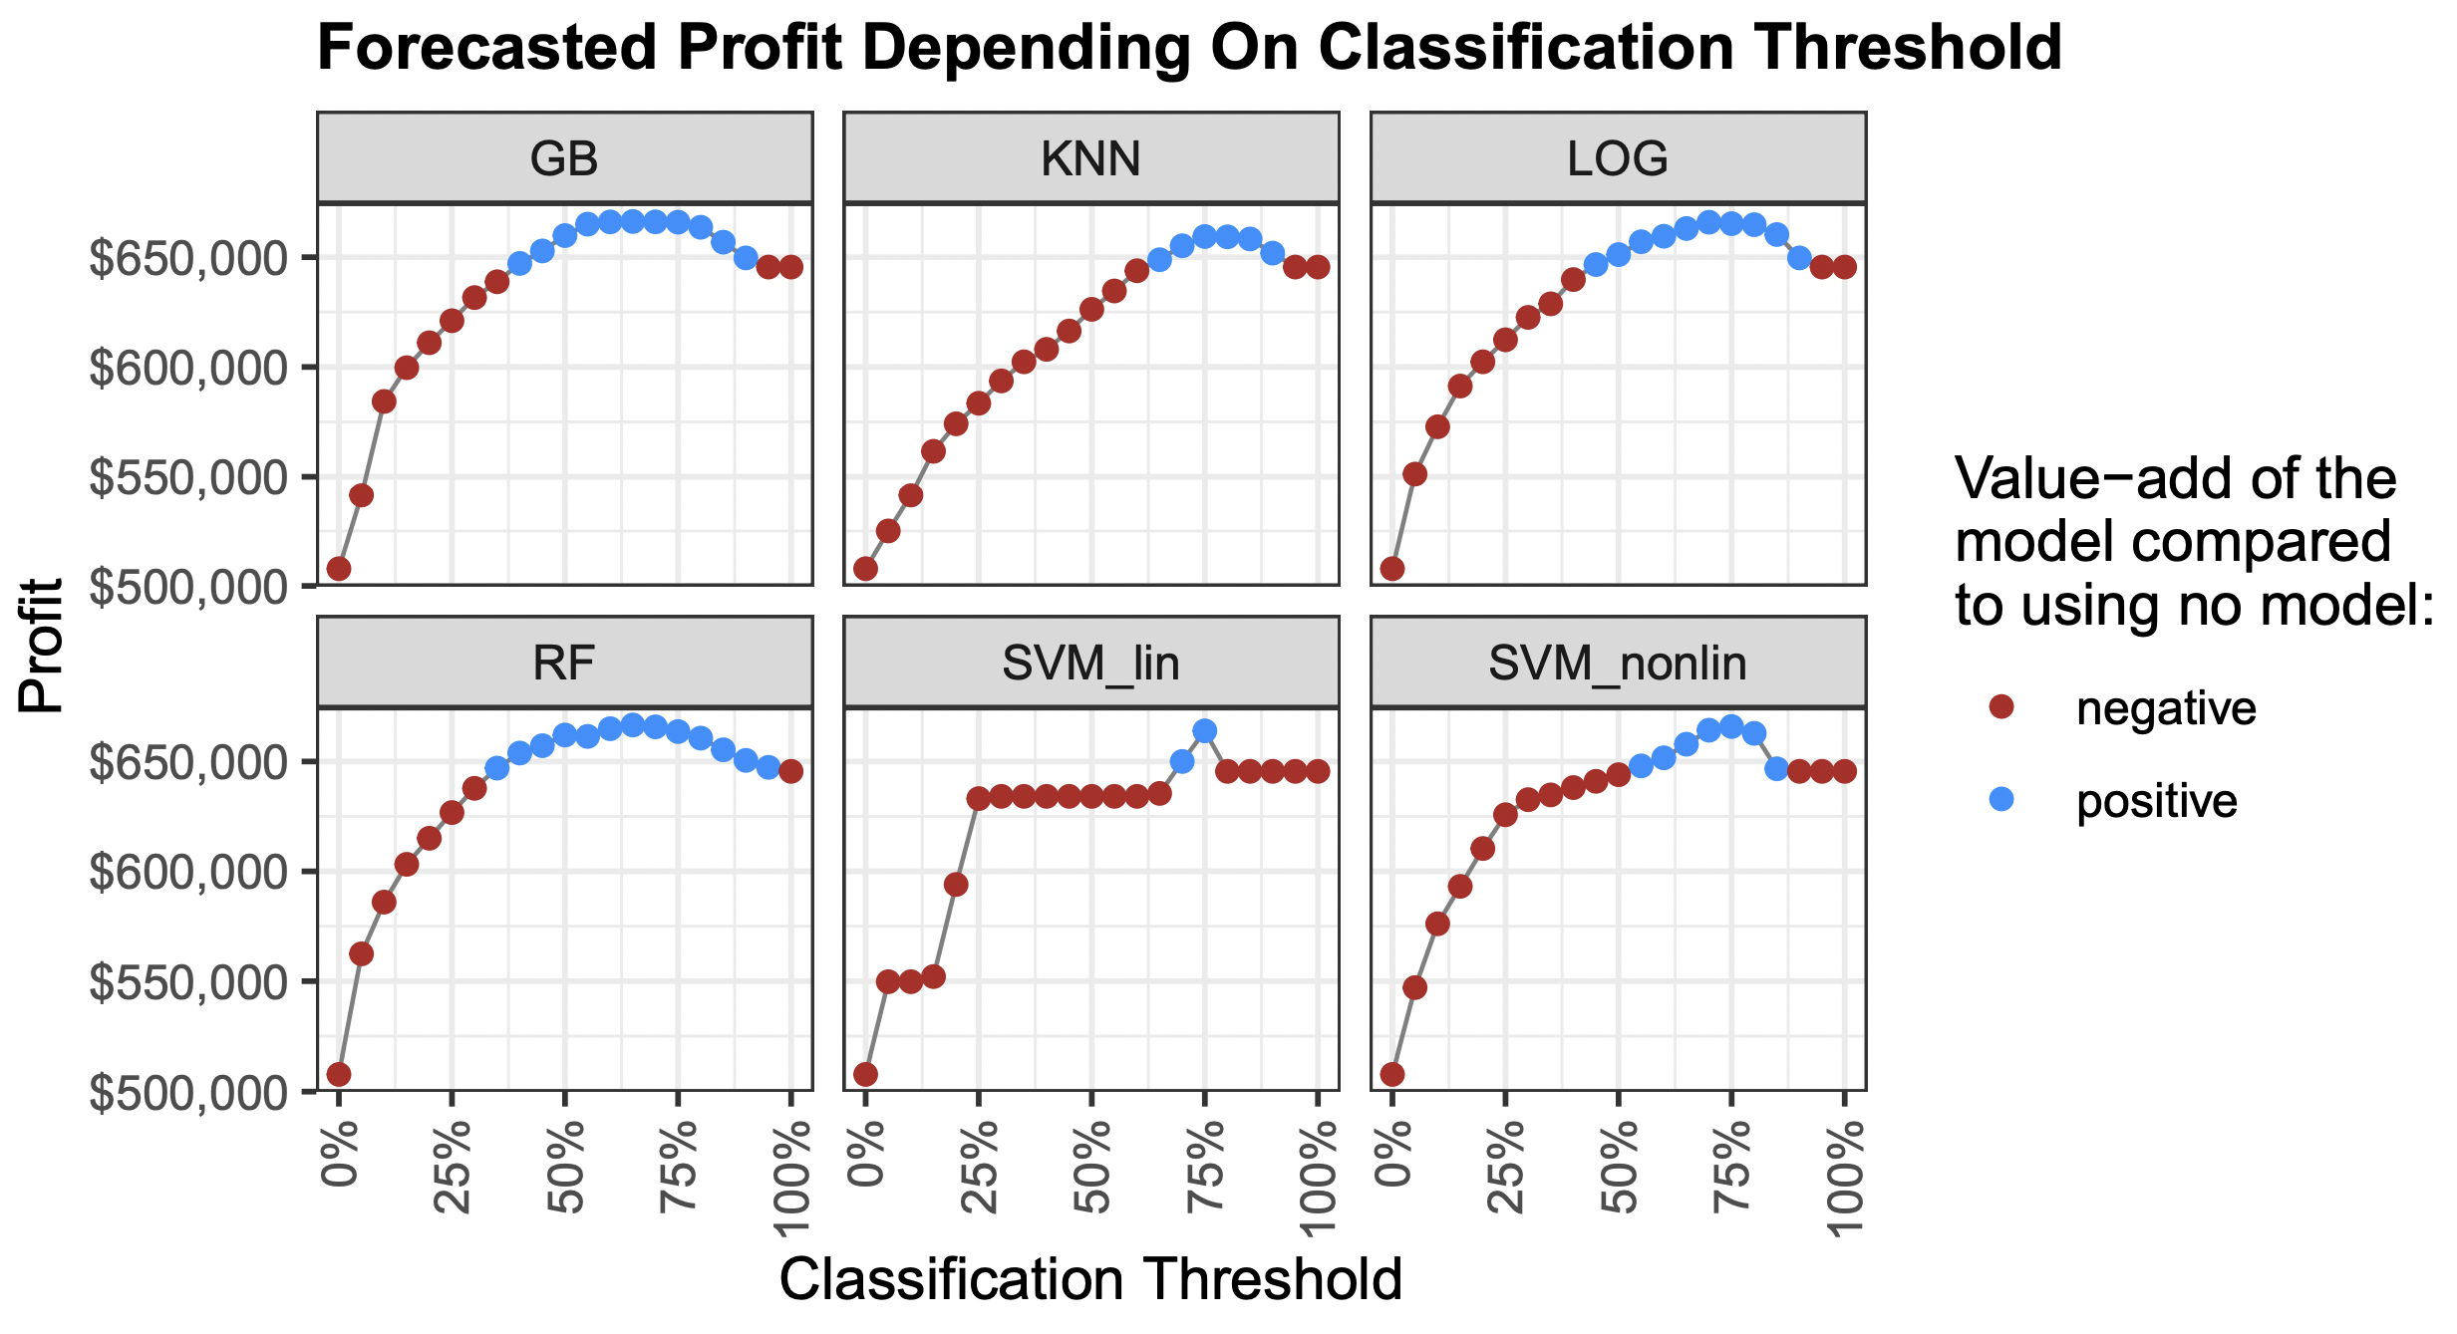
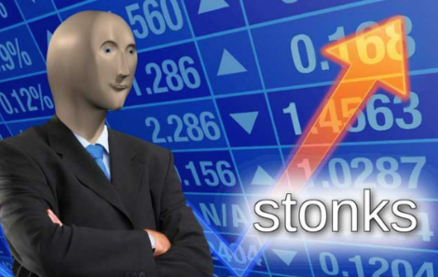
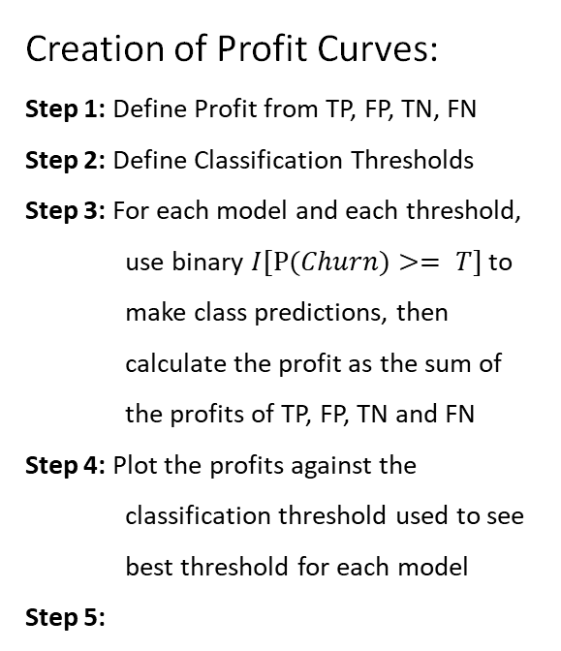
Example of business profit curves
Problem Statement
Data & Packages
Data Analysis
Model Creation
Performance Evaluation
Business Case & Ethics
Creation of Profit Curves:
Step 1: Define Profit from TP, FP, TN, FN
Step 2: Define Classification Thresholds
Step 3: For each model and each threshold, use binary $I[P(Churn)⁡>= T]$ to make class predictions, then calculate the profit as the sum of the profits of TP, FP, TN and FN
Step 4: Plot the profits against the classification threshold used to see best threshold for each model
Step 5:
Notes:
Example of 500 USD vs 0 USD ->
Profit Curves Charts (by Confusion matrix)
Both SVM methods are erratic or narrow value add threshold range
kNN is insufficient, corresponding to ROC AUC result
Tree based model and logistic regression looks promising (smoother lines and wider range)
Classification threshold of tree-based model are much lower -> better trade-off at default threshold?
(Winner!) Random forest generates highest profit
Stack linear model performance is not comparable?

Slide 20
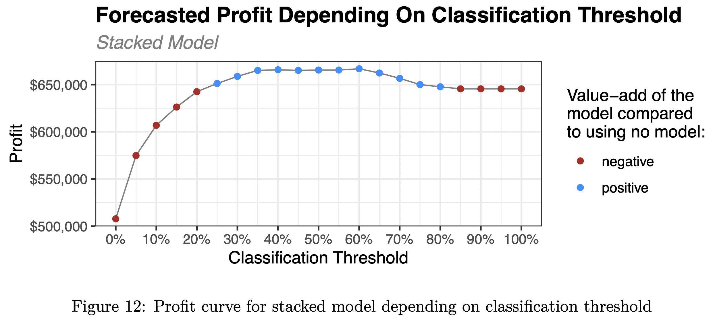
Stacked model profit curve
Problem Statement
Data & Packages
Data Analysis
Model Creation
Performance Evaluation
Business Case & Ethics
Profit Curves
Advantages:
Visual interpretation
Comparison to baseline (no model)
Disadvantages:
Hard to pinpoint exact ideal threshold
Hard to compare models visually
→ Solution: Get max profit impact for each model

Slide 21
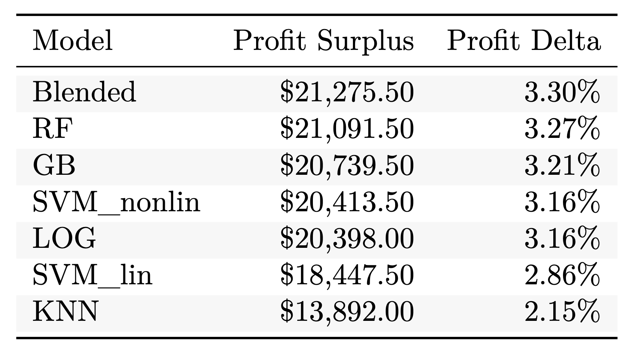
Example of business profit curves
Problem Statement
Data & Packages
Data Analysis
Model Creation
Performance Evaluation
Business Case & Ethics
Initial Takeaway: Blended Model
Minimal marginal performance gain, but huge marginal downside of complexity and computational expensiveness for retraining
Maximum impact on forecasted profit for each model
Notes:
Example of 500 USD vs 0 USD ->
Profit Curves Charts (by Confusion matrix)
Both SVM method are erratic or narrow value add threshold range
kNN is insufficient, corresponding to ROC AUC result
Tree based model and logistic regression looks promising (smoother lines and wider range)
Classification threshold of tree-based model are much lower -> better trade-off at default threshold?
(Winner!) Random forest generates highest profit
Stack linear model performance is not comparable? ()

Slide 22
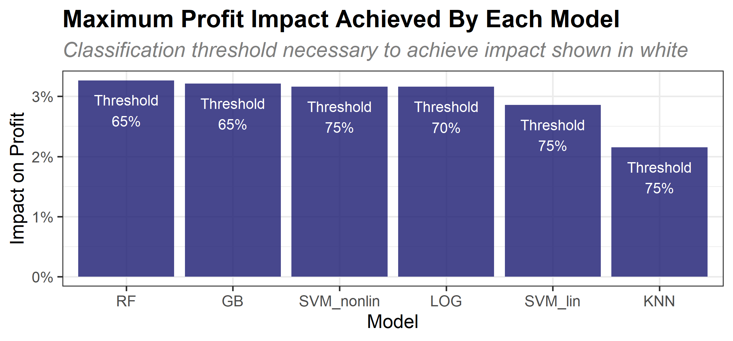
Thresholds for highest profit impact
Problem Statement
Data & Packages
Data Analysis
Model Creation
Performance Evaluation
Business Case & Ethics

Slide 23







Performance assessment for business
Problem Statement
Data & Packages
Data Analysis
Model Creation
Performance Evaluation
Business Case & Ethics
Metrics
GB
RF
LOG
kNN
SVM_lin
SVM_nonlin
Stacked model
Explainability
Profit impact
Threshold range
Stability
Model performance assessment
23

Slide 24
Conclusion from profit curves
Problem Statement
Data & Packages
Data Analysis
Model Creation
Performance Evaluation
Business Case & Ethics
2.15% - 3.30%
of profit increase with any of our models
Logistic regression
model is recommended to start with for our business case

Slide 25
Ethics Discussion
Potential pitfalls in practice

Slide 26
Eight principles of ethical design
Problem Statement
Data & Packages
Data Analysis
Model Creation
Performance Evaluation
Business Case & Ethics
Well-Being
Data Agency
Effectiveness
Transparency
Accountability
Awareness of Misuse
Competence
Human Rights
Company provides discount which benefits the customers based on model predictions
No sensitive or personal data included
Systematic approach with promising performance
Decision-making basis not available for customers
Limited transparency → No accountability
No significant potential for misuse
Simple logistic regression functions as fallback in case the competence and skill is lacking for random forest
Procedural fairness, model doesn’t discriminate
Sources: (IEEE, n.d., p. 11)
Notes:
Finally, we are going to look at whether our model is ethical or not based on the eight principles of ethical design.

Slide 27
Thank you! Any questions?
?
?
?

Slide 28
References
Apply SMOTE Algorithm. (n.d.). https://themis.tidymodels.org/reference/step_smote .html. (Accessed: 2022-11-18)
BlastChar. (2018, Feb). Telco customer churn. Retrieved from https://www.kaggle.com/ datasets/blastchar/telco-customer-churn
From principles to practice ethically aligned design conceptual ... - ieee. (n.d.). IEEE. Retrieved from https://ethicsinaction.ieee.org/wp-content/uploads/ead1e _principles_to_practice.pdf
Karanovic, M., Popovac, M., Sladojevic, S., Arsenovic, M., & Stefanovic, D. (2018). Telecommunication services churn prediction-deep learning approach. In 2018 26th telecommunications forum (telfor) (pp. 420–425).
Morse, L., Teodorescu, M. H. M., Awwad, Y., & Kane, G. C. (2021). Do the ends justify the means? variation in the distributive and procedural fairness of machine learning algorithms. Journal of Business Ethics, 1–13.
Zhao, M., Zeng, Q., Chang, M., Tong, Q., & Su, J. (2021). A prediction model of customer churn considering customer value: an empirical research of telecom industry in China. Discrete Dynamics in Nature and Society, 2021.

Slide 29
Appendix
More information on the project

Slide 30
Appendix - Variables Descriptions (1/2)
Customers who left within the last month
Customer account information
Demographic information
Services that each customer has signed up for
Churn
Phone, multiple lines, internet, online security, online backup, device protection, tech support, and streaming TV and movies
How long they’ve been a customer, contract, payment method, paperless billing, monthly charges, and total charges
Gender, age range, and if they have partners and dependents
30

Slide 31
Appendix - Variables Descriptions (2/2)
Variable | Description
customerID | Customer ID
gender | Whether the customer is a male or a female
SeniorCitizen | Whether the customer is a senior citizen or not (1, 0)
Partner | Whether the customer has a partner or not (Yes, No)
Dependents | Whether the customer has dependents or not (Yes, No)
tenure | Number of months the customer has stayed with the company
PhoneService | Whether the customer has a phone service or not (Yes, No)
MultipleLines | Whether the customer has multiple lines or not (Yes, No, No phone service)
InternetService | Customer’s internet service provider (DSL, Fiber optic, No)
OnlineSecurity | Whether the customer has online security or not (Yes, No, No internet service)
OnlineBackup | Whether the customer has online backup or not (Yes, No, No internet service)
DeviceProtection | Whether the customer has device protection or not (Yes, No, No internet service)
TechSupport | Whether the customer has tech support or not (Yes, No, No internet service)
StreamingTV | Whether the customer has streaming TV or not (Yes, No, No internet service)
StreamingMovies | Whether the customer has streaming movies or not (Yes, No, No internet service)
Contract | The contract term of the customer (Month-to-month, One year, Two year)
PaperlessBilling | Whether the customer has paperless billing or not (Yes, No)
PaymentMethod | The customer’s payment method (Electronic check, Mailed check, Bank transfer (automatic), Credit card (automatic))
MonthlyCharges | The amount charged to the customer monthly
TotalCharges | The total amount charged to the customer
Churn | Whether the customer churned or not (Yes or No)
31

Slide 32
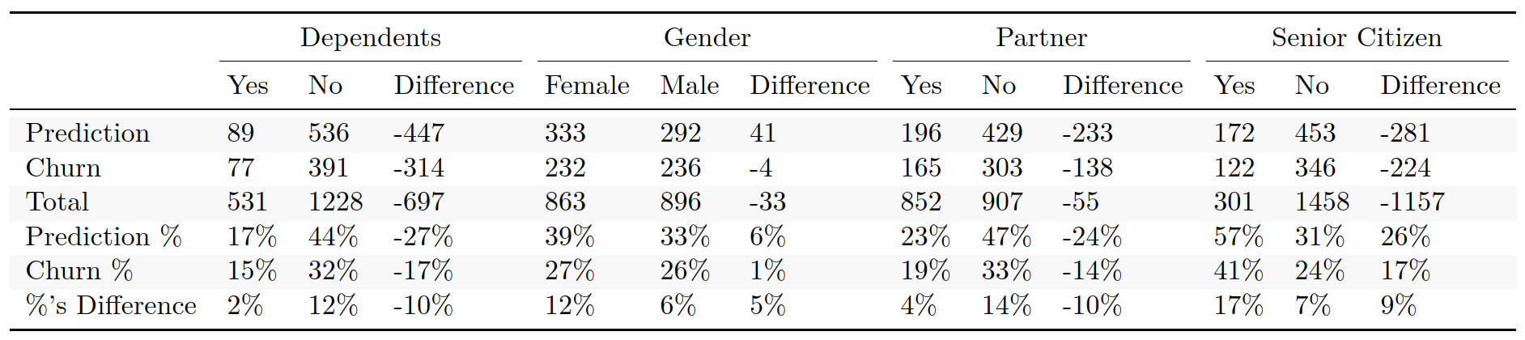
Appendix - Evaluation of procedural fairness
Procedural fairness: Decision process the same for all participants
Prediction close to actual churn rate for identity-related categorical values of the same predictor
Exp. Difference between prediction and churn rate for male and female should be similar
Low variable importance of Dependents, Gender, Partner and Senior Citizen → Procedural Fairness
(Morse, Teodorescu, Awwad, & Kane, 2021, p. 2)
32

